Slide 1


Welcome To Presentation on Machine Learning for a 5G Future

Slide 2
Developed By
NAME | ID
Mahbuba Zaman Mitu | IT-16044

Slide 3
Supervised By
Nazrul Islam
Assistant Professor
Dept. of Information & Communication Technology, MBSTU.

Slide 4

Machine Learning For 5G Future

Slide 5
Cont.….
What is Machine Learning?
What is advantages of Machine Learning?
Does Machine Learning have a future?
What is scope of Machine Learning?
What is features of 5G?
What is Equipment for 5G?
How does 5G work?
Is 5G how will 5G affect potential of Machine Learning to support 5G requirement in has Mobile Broadband.

Slide 6
Machine Learning
Machine learning is an application of artificial intelligence (AI) that provides systems the ability to automatically learn and improve from experience without being explicitly programmed. Machine learning focuses on the development of computer programs that can access data and use it learn for themselves.

Slide 7
Advantages of Machine Learning
Data Input from Unlimited Resources. Machine learning can easily consume unlimited amounts of data with timely analysis and assessment.
Fast Processing and Real-Time Predictions.
Practical Scenarios.
Machine Learning in the Medical Industry.
Machine Learning in the Insurance Industry.

Slide 8
The future of Machine Learning
Machine learning is a trendy topic in this age of Artificial Intelligence. The fields of computer vision Natural language processing (NLP) are making breakthroughs that no one could’ve predicted. We see both of them in our lives more and more, facial recognition in your smartphones, language translation software, self-driving cars and so on. What might seem sci-fi is becoming a reality, and it is only a matter of time before we attain Artificial general intelligence.

Slide 9
Scope of Machine Learning
Data architect
Data engineer
Data scientist
Machine Learning engineer
Deep learning engineer

Slide 10
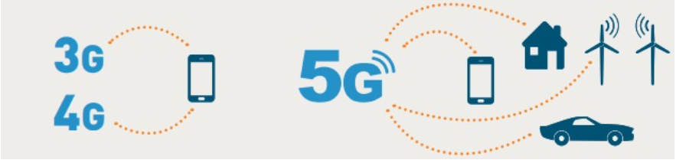
Introduction of 5G
5G is the 5th generation of mobile networks, a significant evolution of todays 4G LTE networks. 5G has been designed to meet the very large growth in data and connectivity of today’s modern society, the internet of things with billions of connected devices, and tomorrow’s innovations5G will initially operate in conjunction with existing 4G networks before evolving to fully standalone networks in subsequent releases and coverage expansions

Slide 11
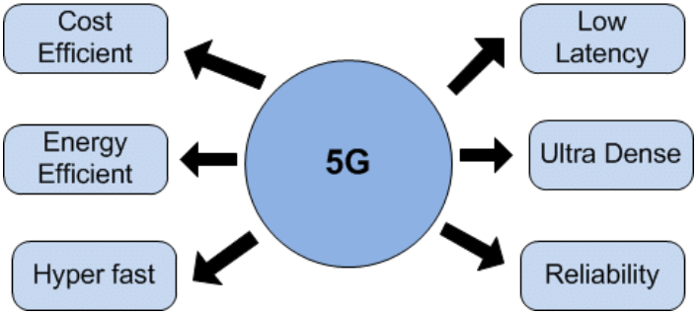
Features of 5G
Emerging 5G networks feature Hyper fast ,cost efficiency, lower latency, higher capacity ,reliability and ultra Dense compared to 4G. These network improvements will have far-reaching impacts on how people live, work, and play all over the world.

Slide 12
Equipment for 5G
5G wireless systems need to handle a variety of traffic types, including enhanced
Mobile broadband.
Massive machine communication.
Low-latency.
High-reliability applications.
New types of multiple access schemes, waveforms, numerologies, and slot structure are part of the standard.

Slide 13
The First applications for 5G
Initial 5G services commenced in many countries in 2019 and widespread availability of 5G is expected by 2025
Fixed wireless access for homes and enhanced mobile broadband services are the first applications using new 5G phones, tablets, wireless access modems and hot spots.

Slide 14
Available Devices For 5G
Mobile handsets, tablets and hot spots equipped with 3G, 4G and 5G connectivity were launched in 2019 and low latency and widespread machine to machine applications using 5G will be developed in the coming years.

Slide 15
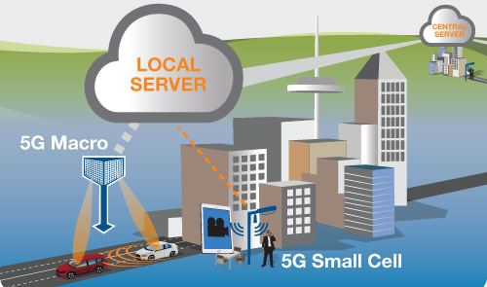
5G Network Architecture

Slide 16
Major Categories for 5G
There are three major categories of use case for 5G:
Massive machine to machine communications – also called the Internet of Things (IoT) that involves connecting billions of devices without human intervention at a scale not seen before.
Ultra-reliable low latency communications --also opens up a new world where remote medical care, procedures, and treatment are all possible
Enhanced mobile broadband – providing significantly faster data speeds and greater capacity keeping the world connected.

Slide 17
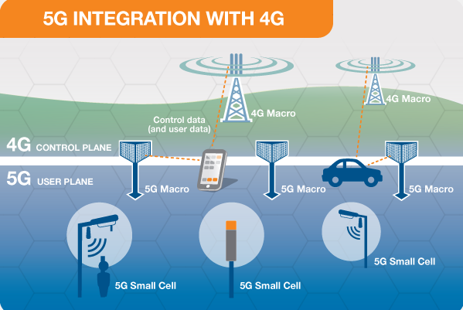
5G Working With 4G
When a 5G connection is established, the User Equipment (or device) will connect to both the 4G network to provide the control signaling and to the 5G network to help provide the fast data connection by adding to the existing 4G capacity.

Slide 18
Is 5G How will 5G affect L potential of machine learning to support 5G requirement in has mobile broadband
5G is still a cellular broadband technology and is a network of networks.
Beyond providing network services, MNOs will be able to develop and operate new IoT services.
Implementing 5G networks while keeping 3G and 4G networks operational will likely trigger a new challenge for MNOs regarding the ability of frequencies in the spectrum (mainly if the forecasted massive volume on IoT occurs).

Slide 19
Conclusion
Machine learning approaches applied in systematic reviews of complex research fields such as quality improvement may assist in the title and abstract inclusion screening process. Machine learning approaches are of particular interest considering steadily increasing search outputs and accessibility of the existing evidence is a particular challenge of the research field quality improvement

Slide 20


